Slide 1
LMS Analytics Strategy and Predictive Performance Reporting
for Rychtenshane Community Housing Group
1
T I T L E P A G E
Prepared By :
Joefer Cosio, Kousar Saleem, Mariel Palacio, Vineet Khurana
Notes:
Quick Title Introduction and what is the content of the presentation 1. Brief overview of the project and introduction of team
2. The teams methodology
3. Data cleaning & Data modeling
4. Key Insights Generated
5. KPI’s
6. Answering Business Questions.
7. Recommendations
8. Challenges and Lessons Learned. 9. Dashboard snippets.

Slide 2




2
I N T R O D U C T I O N
O V E R V I E W
RDAMP TEAM #1
RESPONSIBILITIES
A Team of data professionals was engaged to deliver a full analytical solution for RCHG : LMS data.
Responsibilities included data cleaning, modeling for enterprise reporting, and applying statistical techniques ( forecasting, regression, and ANOVA) to support strategic decision-making.
The project focused on collaboration, dashboard development, and delivering clear, evidence-based business recommendations.
PROJECT ORGANIZER DATA VISUALIZATION PROJECT DOCUMENTATION
Joefer Cosio
0
STATISTICAL ANALYSIS INTERPRETATION & CONCLUSION
Kousar Saleem
STATISTICAL ANALYSIS INTERPRETATION & CONCLUSION
Mariel Palacio
DATA MODELING INSIGHTS REPORT & ANALYSIS
Vineet Khurana
Notes:
Overview of the project.
Introduce the team and their core function

Slide 3












3
M E T H O D O L O G Y
WHAT DOES SUCCESS LOOK LIKE?
How Will We Get There?"
What Tools and Skills Will We Use?
Analyze 2000 Course Record from RCHG LMS Data
Deliver a Full Analytical Solution
Clean and Structure the dataset
Design Scalable Data Model Architecture
Build a Dynamic PowerBI dashboard to Answer Business questions
Provide a comprehensive Insights & Analysis Report
Organize and Document the Entire Solution
Project Management
Leverage Work Breakdown Structure (WBS) using Kanban methodology
Define Availability Breakdown — clarify team time commitment and availability
Assign Project Owner roles — ownership and accountability for each task
Execution Phases
P1 – Define the Problem
P2 – Build the Data Model
P3 – Perform Statistical Analysis and
Create Dynamic Dashboard
P4 – Provide Insights & Analysis Report
P5 – Document the Full Solution
Notes:
Explain our methodology , what are our success criteria , how can we succeed , what tools to succeed .
Python (pandas, matplotlib, statsmodels, pmdarima, seaborn, scikit-learn, prophet, numpy) — for statistical analysis
Power BI — for data visualization using best practices and design techniques
Excel — for initial data cleaning and preprocessing
Kanban — for workflow and project management
GitHub, Google Colab, Jupyter Notebook — for collaboration, version control, and portfolio sharing
Slack — for communication and daily huddles
Microsoft Word & PowerPoint — for documentation and final reporting

Slide 4
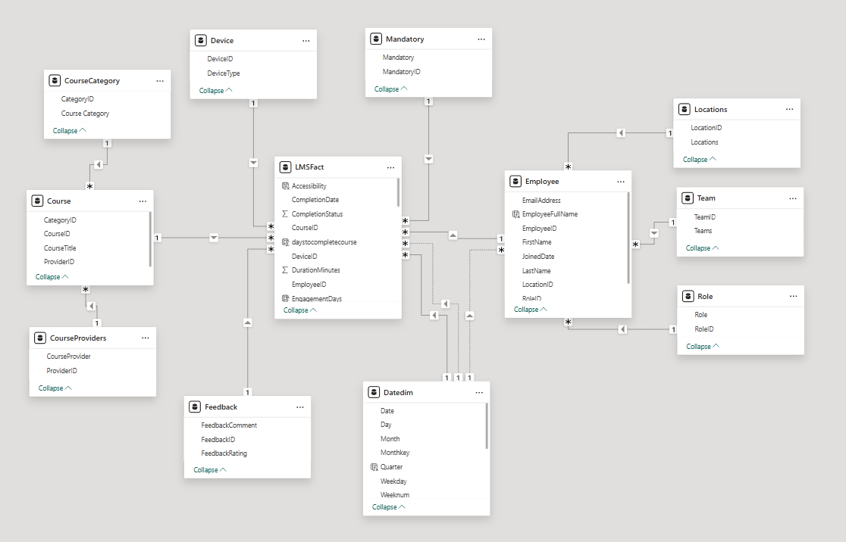
4
D A T A C L E A N I N G & D A T A M O D E L I N G
Data Cleaning
Key dates were standardized.
Categorical values were cleaned for consistency and missing scores were replaced with zeros. Text fields were trimmed, and a new metric, DaysToComplete, was created to track course duration.
Data Modeling
Design A Snowflake-Schema with 1 Fact and 11 Dimensions.
Approach a snowflake-schema instead of star-schema to normalizes dimension tables, reducing data redundancy while supporting complex hierarchical relationships.
Steps | Column | Action
Standardized Dates | EnrollmentDate CompletionDate LastAccessDate | YYYY-MM-DD
Clean Categories | IsMandatory | Replace No (30) => No
Clean Categories | FeedbackRating | Replace Very Useful : 4 => Very Useful : 3
Clean Null Values | Score | Replace Null Values to 0
Clean and Trim | All | Trim whitespaces
Create DaytoComplete | Daystocomplete | Calculate duration in Days
Notes:
Data cleaning process and Data modeling Design. Why we chose Snowflake vs Star Schema

Slide 5
5
K E Y I N S I G H T S
Key Strengths
High Engagement in Mandatory Courses: Mandatory courses show stronger engagement (80% completion) compared to regular courses (78%), despite being significantly more in volume (1,709 vs. 291).
Trafford Branch Leads in performance: Trafford leads in both course completion (418 courses) and lowest overdue rate, indicating strong compliance culture and learning engagement.
Strong Role-Based Performance: Network Technicians lead in performance (85% completion, 15% overdue), with Maintenance Technical and Support roles showing highest skill scores.
Finance Course Excellence: Finance category boasts the highest completion (87%) and lowest overdue (13%), with a strong average skill score (3.07) and performance score (80.71), showcasing domain strength. FOR REVIEW
Q4 Shows Consistent Performance: Despite other quarters having higher course completions, Q4 has the lowest count overdue courses (93), suggesting improved end-of-year learning accountability and completion urgency.
Key Weaknesses
Rocky Start in 2025 and Q1 Overdue: 2025 shows a weaker LMS engagement trend, especially in Q1. This disrupts the usual trend where Q2 typically performs best and signals a need for a year-start compliance push.
Compliance Courses Lag: Compliance has the lowest completion rate (77%) and highest overdue (23%). Payroll compliance is a critical weak spot (73% completion, 27% overdue).
Skill Gaps Persist in High-Demand Roles: Despite high learning hours, IT roles show the highest skill gaps (e.g., IT Support Officer: 118), and System Analysts record the lowest average score (78) and skill score (2.92).
Wythenshawe Central Underperformance: This location shows lowest course completion, highest overdue, lowest skill score (2.98), and least time spent learning—requiring immediate intervention.
Disparity in Course Allocation Across Teams: Facilities team has significantly fewer courses assigned (276) and lowest LMS hours (349), yet show high completion and lower skill gaps, indicating inconsistent expectations across teams.
Underutilization of Mobile and Screen Readers: Desktop is dominant (919 hrs) vs. mobile (782 hrs). Screen reader usage, though beneficial, is underused in essential training areas (e.g., cybersecurity, onboarding).
Notes:
You can display the powerbi dashboard first
DATA DRIVEN INSIGHTS FROM DASHBOARD

Slide 6
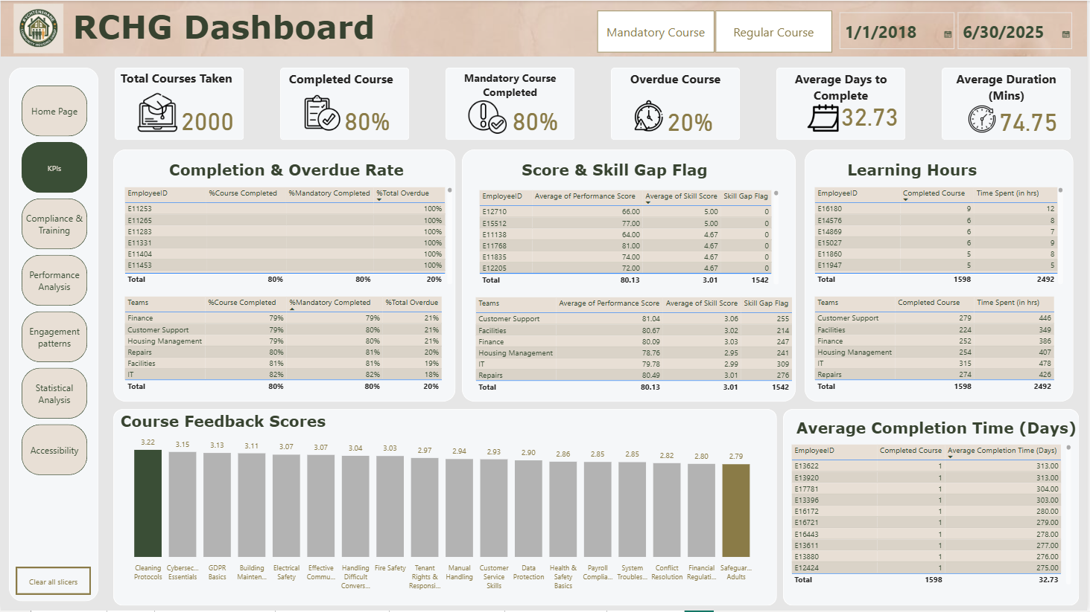
6
K P I s
Completion Rate by team / by employee
Overdue Rate by team / by employee
Avg Completion Time(days) by employee
Learning Hours by team / by employee
Skill Gap by team
Performance score by team / by employee
Skillscore by team/ by employee
Course Feedback Rating
Notes:
You can display the powerbi dashboard first
DATA DRIVEN INSIGHTS FROM DASHBOARD

Slide 7
7
B U S I N E S S Q U E S T I O N S I
What is the current completion rate of mandatory courses across departments and locations?
How actively are employees engaging with the LMS? (Devices used, duration, access patterns, etc.)
What trends are evident in skill development, feedback, and review scores?
The Overall Completion rate for mandatory courses is 80%
By Department : IT and Facilities department lead with over 82% completion , reflecting strong compliance engagement
By Location : Trafford Branch has the highest completion rate (360 completions out of 442 mandatory courses, 81% overall)
Employees engage actively with the LMS across devices—desktop (36%), tablet (32%), and mobile (32%)—showing flexible access. Average time per course is 75 minutes, with a 77-day span from enrollment to last access, suggesting spaced learning. Notably, 21% of users rely on screen readers, and they demonstrate higher average scores (81.08 vs. 79.88).
Skill scores across courses are generally consistent, averaging around 3.0. Strong performers include Health & Safety Basics (3.30) and Customer Service Skills (3.09), while Safeguarding Adults (2.80) and Cleaning Protocols (2.89) lag behind. Feedback scores show similar patterns, with lower-rated courses often aligning with lower skill outcomes. Although Cleaning Protocols has lower skill scores, it receives the highest feedback (3.22), suggesting learners value the experience but gain fewer practical skills. This highlights opportunities to improve specific courses to boost learning impact.
Notes:
ANSWERING BUSINESS QUESTIONS

Slide 8
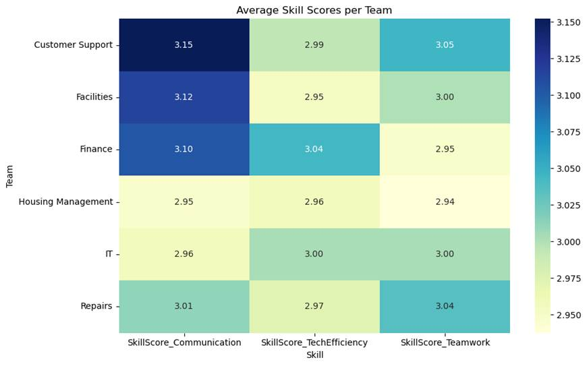
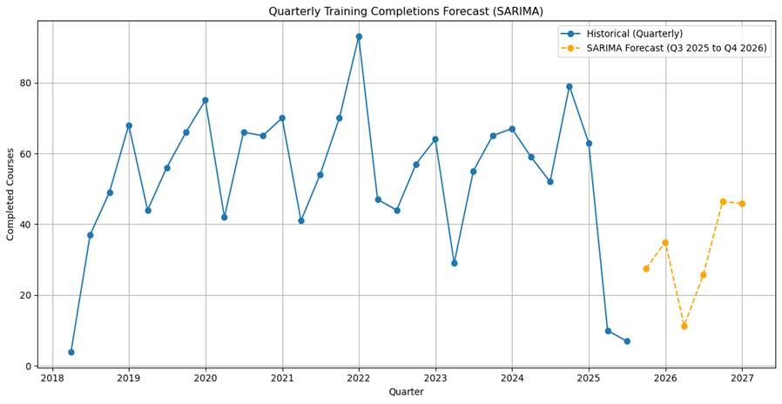
8
B U S I N E S S Q U E S T I O N S II
BUSINESS QUESTIONS
4. Are there statistically significant differences in skill scores across teams or roles?
5. Can we predict future training needs or compliance risks using historical data?
The p-values for all skill areas and overall performance scores were above the 0.05 threshold, indicating no statistically significant difference in performance scores between teams. This suggests a consistent training and skill development experience across departments, with no team outperforming or underperforming significantly on average.
Using ANOVA method to tests if the mean performance scores across multiple groups (teams) vary in a statistically meaningful way. we conclude that employee performance in terms of communication, technical efficiency, and teamwork is uniform across teams. This reinforces the notion that the training program offers a balanced impact regardless of departmental assignment.
Yes! By analysing historical training completion trends and build forecasting models to predict future completions. The Accurate forecasting supports proactive training resource allocation and organizational planning.
Using SARIMA to model the number of quarterly training completions , Trained on historical data from 2018 to 2025. The predicted completion for Q3 2025 is 27.46
To provide accurate analysis , Additional data point conducted using facebook Prophet to compare with SARIMA datapoints The SARIMA model provided more accurate short-term forecasts, especially during sharp declines in 2025, while Prophet better captured overall growth but consistently overestimated completions.
Notes:
STILL ANSWERING BUSINESS QUESTIONS

Slide 9
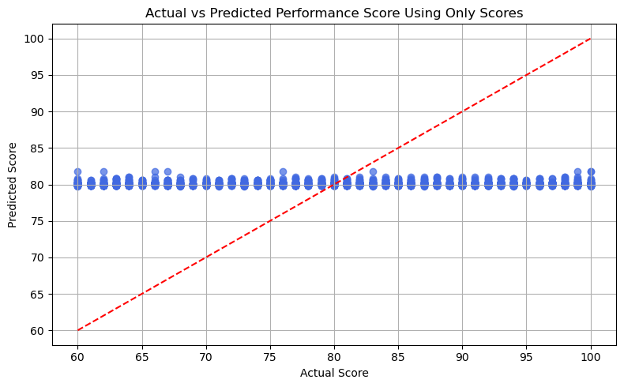
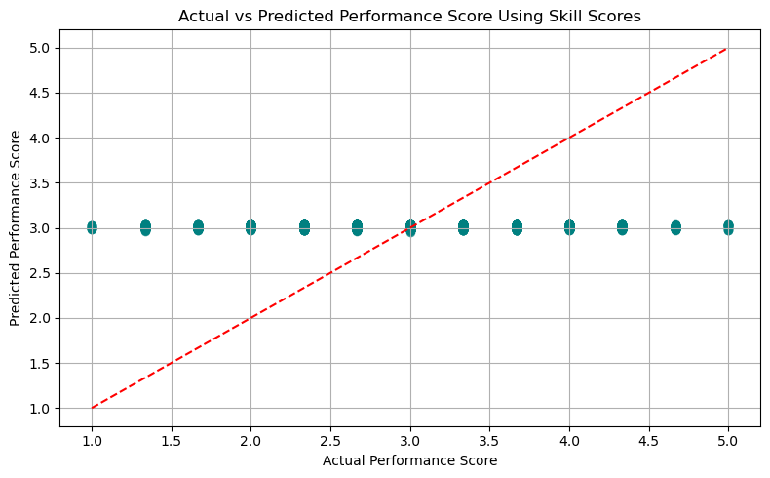
9
B U S I N E S S Q U E S T I O N S III
6. How do course engagement levels relate to performance review outcomes?
linear regression model : Analysing two key training variables training duration and course frequency if it influence overall employee performance. A. Performance Score ( 0 -100 scale) B. Skill Score ( 0 - 5 scale)
Time alone doesn’t guarantee improved performance. It may reflect difficulties, distractions, or inefficiencies in training.
Repetition helps boost scores, but improvement in skill application may require deeper or more targeted learning formats.
Regression Conclusion : The regression analysis confirms that both training duration and course frequency positively influence performance, though the effect sizes are modest. Course frequency appears to be a more meaningful predictor than total duration, hinting that variety or repetition of learning may matter more than total time investment. From a policy perspective: 1- Encourage structured multi-course training paths rather than isolated long-duration courses. 2- Monitor and optimize training hours to ensure time spent translates into measurable performance gains.
Notes:
MORE ANSWERING BUSINESS QUESTIONS

Slide 10
10
R E C O M M E N D A T I O N S
Key Recommendations
Address Compliance Category Gaps Proactively
Boost Q1 and Start-of-Year Learning Engagement
Strengthen Underperforming Roles and Locations
Standardize Training Load Across Teams
Enhance Learning Accessibility & Mobility
Implement Role-Based Learning Pathways
Introduce Learning Accountability Dashboards.
Key drivers to make this success:
Define and track the KPIs every Quarter.
Let manager drive the KPI performance
Build a dashboard for manager to track performance
Make this a part of performance review and one of the promotion criteria.
Growth Opportunity
By leveraging high-performing areas and applying focused strategies to underperforming quarters, roles, and categories, the company can build a more consistent, accessible, and high-impact learning culture. A quarterly pulse check, improved training design, and role-specific engagement plans will enable sustainable compliance growth and skills development.
Notes:
Talk about the recommenadtions and future strategies. 1. Address Compliance Category Gaps Proactively
Prioritize Payroll Compliance and Finance team compliance performance with dedicated refreshers, tracked deadlines, and automated follow-ups.
Consider segmenting compliance training by risk/criticality level to better align content with learner relevance.
2. Boost Q1 and Start-of-Year Learning Engagement
Launch quarterly campaigns or learning challenges to combat Q1 inertia and avoid backloading completions into Q4.
Include manager-level nudges or KPI integration to foster accountability early in the year.
3. Strengthen Underperforming Roles and Locations
Deploy focused training interventions for Wythenshawe Central and System Analysts, including skill-specific mentoring or diagnostics.
Apply best practices from Trafford and Network Technicians as internal benchmarks.
4. Standardize Training Load Across Teams
Conduct a course load audit to ensure equitable and role-appropriate distribution across teams like Facilities, Repairs, and Customer Support.
5. Enhance Learning Accessibility & Mobility
Optimize LMS design for mobile responsiveness and screen reader integration, especially in high-risk or onboarding courses.
Track accessibility usage trends and promote tools to employees needing additional learning support.
6. Implement Role-Based Learning Pathways
Develop structured learning journeys tailored to each role or department, especially those with high skill gaps (e.g., IT Support, System Analyst, Repairs)
7. Introduce Learning Accountability Dashboards
Develop manager-level dashboards that display their team's course completion rates, overdue status, skill scores, and time spent on LMS.
Incorporate learning metrics into monthly team reviews and performance discussions. Recognize top performers and flag underperformance early.

Slide 11
11
C H A L L E N G E S & L E S S O N S L E A R N E D
Challenges
Time Zone and Availability Constraints: Coordinating across different time zones and aligning with everyone’s availability posed a challenge in making timely decisions and finalizing tasks. To overcome this, we leveraged collaboration tools such as Slack and Microsoft Excel to delegate responsibilities, maintain visibility on task progress, and ensure asynchronous communication was effective.
Dataset Quality and Alignment: The initial dataset provided had inconsistencies and, upon cleaning, did not yield meaningful insights. This issue was promptly raised, and a revised dataset was shared, which resolved the misalignment and allowed the team to proceed with analysis.
Lessons Learned
Adaptability: Working in a team often requires flexibility—not only in terms of schedules but also in adapting to different viewpoints. Balancing individual contributions with team consensus was key to driving the project forward.
Communication: Establishing clear communication channels and selecting the right tools is critical, especially when working remotely or across different time zones. Proactive updates and regular check-ins significantly improved collaboration and clarity.
Leverage on Team Strengths: Each team member brought unique skills and perspectives. Recognizing and utilizing these strengths helped us divide tasks more efficiently and deliver higher-quality results.
Improving technical skills: The project provided a valuable opportunity to enhance technical capabilities, particularly in statistical analysis and data interpretation, which contributed to both personal and team growth.
Notes:
Teams challenged and lessons learned throughout the project

Slide 12
END THANK YOU RDAMP TEAM & TEAM#1 ( Vineet , Mariel , Kousar, Joe)
12
END
Notes:
END! SHOUT OUT TO THE TEAM! JOB WELL DONE!

Slide 13
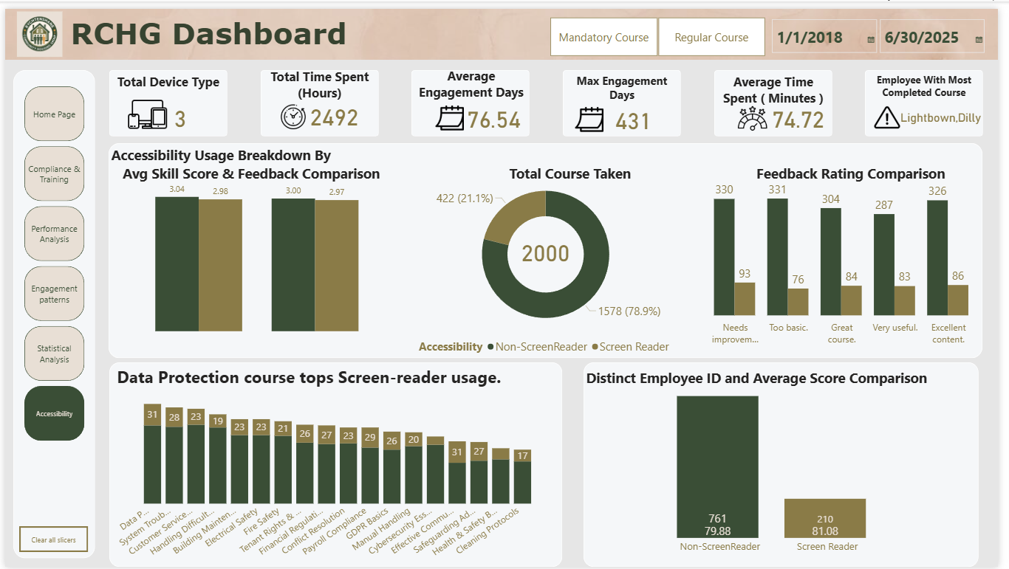
13
D A S H B O A R D _ A C C E S S I B I L I T Y
Notes:
KPI Cards: Retained, this provide continuity while interpreting deeper analytical results.
Forecasting: Predict Training Completions (SARIMA): Time series chart showing predicted training completions for the next 12 months or 4 quarters. Helps anticipate future compliance workloads and training resource needs.
Regression Analysis: Training Time & Frequency vs. Score, Scatterplot with regression line modeling the relationship between Total training time,Number of trainings, Performance scores Aimed at understanding how effort translates into results.
ANOVA Results: Skill Scores Across Teams: Compare training time geographically. Boxplot of skill score distributions per team Heatmap showing scores per team. Confirming that no statistically significant differences were found between teams. Therefore, we do not reject the null hypothesis.e

Slide 14
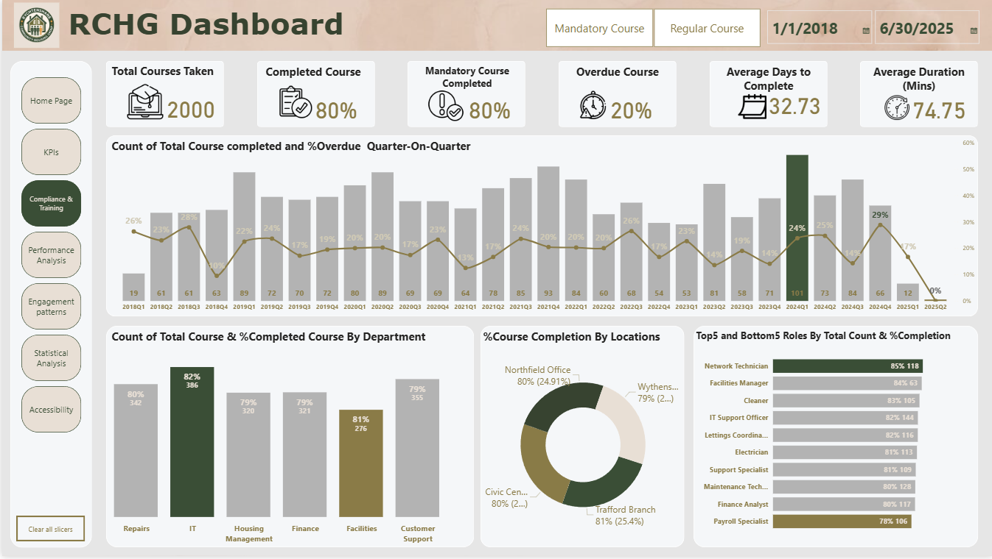
14
D A S H B O A R D _ C O M P L I A N C E & T R A I N I N G
Notes:
KPI Cards:Total Courses Taken, Completed Courses, Mandatory Courses Completed, Overdue Courses, Average Days to Complete, Average Duration (Mins)
Quarter-on-Quarter Trend Chart: Detect seasonal or quarterly shifts in training volume and adherence to deadlines.
Training by Department : Identify departments with high or low completion efficiency.
Training Completion by Location
Top 5 & Bottom 5 Roles by Course Completion: Detect roles that are high-performing in training engagement or at risk.

Slide 15
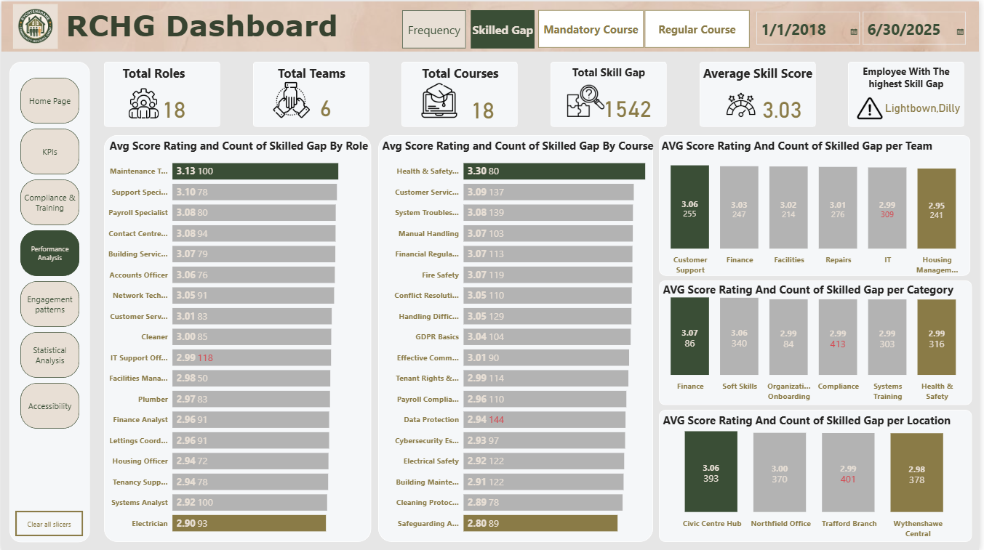
15
D A S H B O A R D _ P E R F O R M A N C E A N A L Y S I S
Notes:
KPI Cards:Total Roles, Total Teams, Total Courses, Total Skill Gaps, Average Skill Score (Communication, Teamwork, Tech Efficiency), Employee With the Highest Skill Gap.
Skill Gap Insights: Visuals highlight where skill development is lagging across roles, courses, teams, categories, and locations - helping identify underperforming areas and prioritize targeted upskilling.

Slide 16
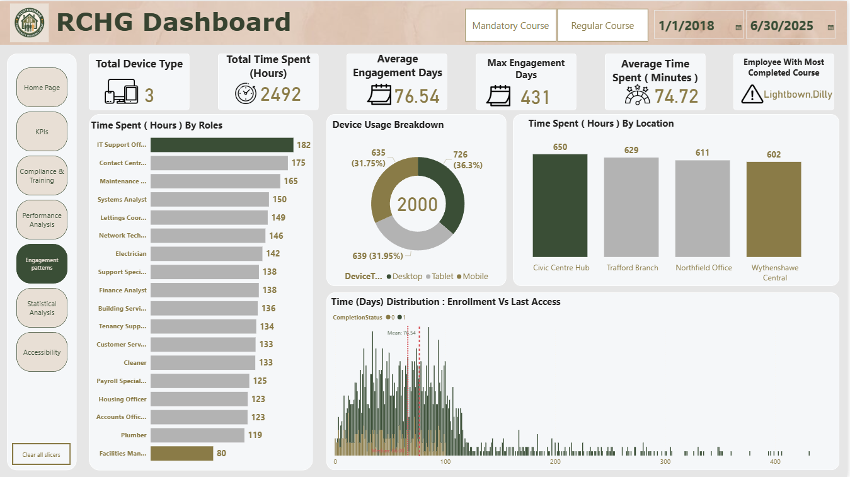
16
D A S H B O A R D _ E N G A G E M E N T P A T T E R N S
Notes:
KPI Cards:
Total Device Types(e.g., Desktop, Mobile, Tablet), Total Time Spent (Hours), Average Engagement Days, Max Engagement Days, Average Time Spent (Minutes), Employee With Most Completed Courses
Time Spent (Hours) by Role: Training effort per job role.
Device Usage Breakdown
Time Spent (Hours) by Location: Compare training time geographically.
Enrollment vs. Last Access (Days): Analyzed how long users take to revisit courses, with mean and median lines for comparison.

Slide 17
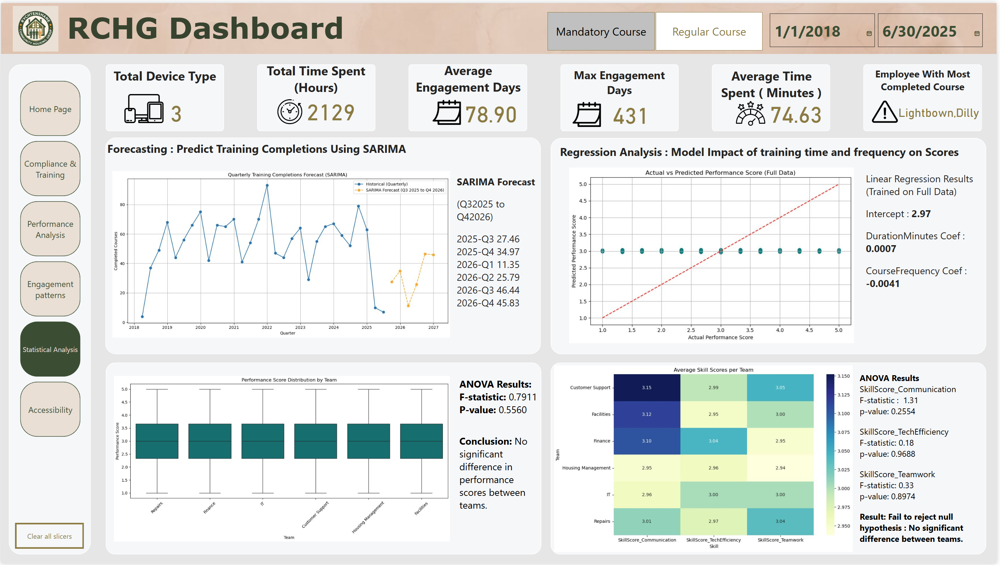
17
D A S H B O A R D _ S T A T I S T I C A L A N A L Y S I S
Notes:
KPI Cards: Retained, this provide continuity while interpreting deeper analytical results.
Accessibility Usage Breakdown: Bar chart comparing skill scores and feedback ratings for screen reader users vs. non-users.
Total Courses Taken (Screen Reader vs. Non-Screen Reader)
Feedback Rating Comparison : Bar chart illustrating differences in qualitative feedback categories (Needs Improvement, Too Basic, Great Course, Very Useful, Excellent Content) segmented by screen reader usage.
Top Courses by Screen Reader Usage: Courses most frequently accessed with a screen reader.
Employee Participation & Score Comparison: Comparative bar chart showing distinct employees using screen readers vs. not, along with their average performance scores.]

Slide 18
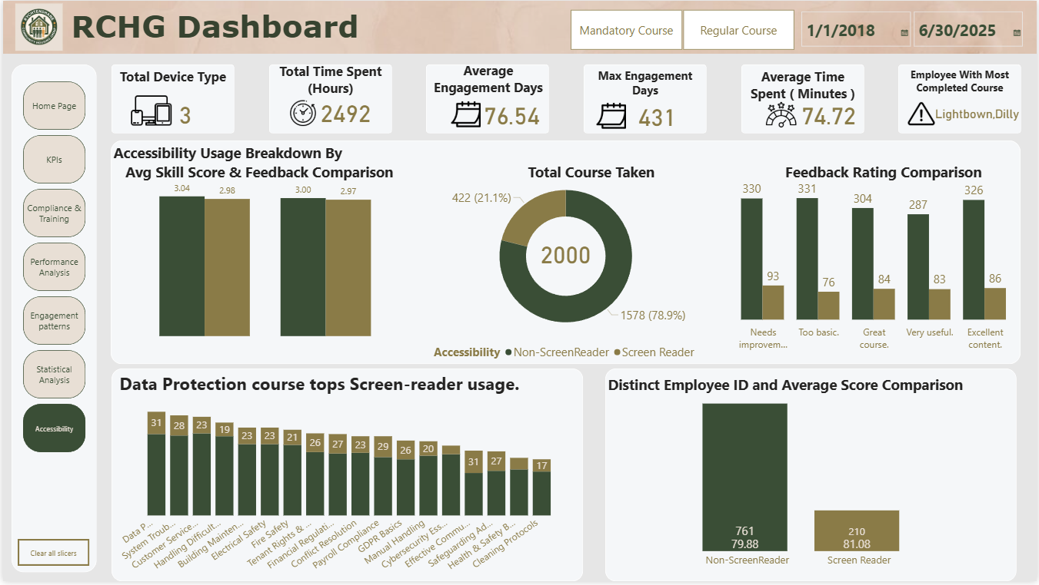
18
D A S H B O A R D _ A C C E S S I B I L I T Y
Notes:
KPI Cards: Retained, this provide continuity while interpreting deeper analytical results.
Forecasting: Predict Training Completions (SARIMA): Time series chart showing predicted training completions for the next 12 months or 4 quarters. Helps anticipate future compliance workloads and training resource needs.
Regression Analysis: Training Time & Frequency vs. Score, Scatterplot with regression line modeling the relationship between Total training time,Number of trainings, Performance scores Aimed at understanding how effort translates into results.
ANOVA Results: Skill Scores Across Teams: Compare training time geographically. Boxplot of skill score distributions per team Heatmap showing scores per team. Confirming that no statistically significant differences were found between teams. Therefore, we do not reject the null hypothesis.e

